Slide 1
India in the Global Economy
Presented by: Vaibhav Sharma
Author: Dr. Raghuram Rajan

Slide 2
CONTENTS
International Trade
Exchange Rate
Goldilocks Rate
Foreign Direct Investment
The Scenario Now
Conclusion

Slide 3
Overview
Global Economy is struggling to achieve pre recession growth rate
IMF downgrades its growth forecasts,
Slow Recovery due to debt overhang (households, banks, governments)
Does writing down debt makes sense?
The road ahead for emerging markets
Industrial countries are engaged in aggressive monetary policies and emerging markets like India’s always faces a risk of capital outflow if foreign investors see it as a risky investment

Slide 4
What should we do?
Promote strong and sustainable growth
Monetary Policy- Now a whole committee will form the policy rather than a single person
Clean up the stressed assets in banking
No functioning bankruptcy system,
SBI lost $1.28 bn, PNB lost $2bn
looking forward to clearing the Non Performing Assets

Slide 5
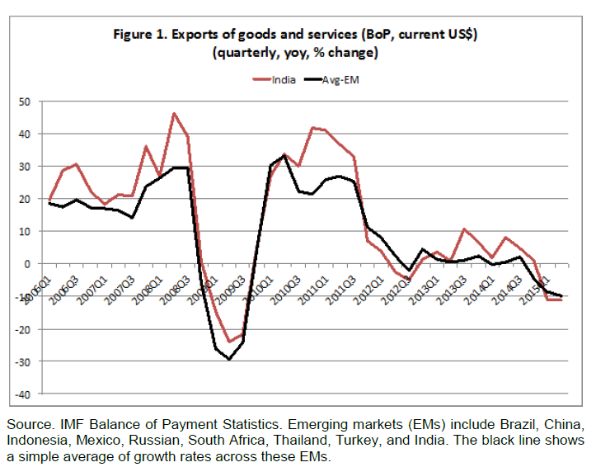
International Trade
Global trade is growing slowly than the global output
→as countries get richer, non-traded services constitute a greater fraction of GDP, causing GDP to grow faster than trade
→with trade-intensive capital goods’ investment muted because of global overcapacity, trade grows more slowly than GDP.
India lost competitiveness due to change in commodity prices and it could not cope up

Slide 6
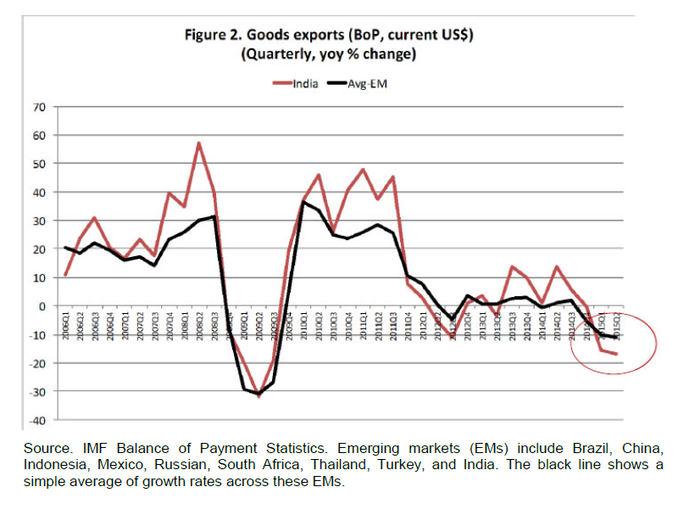

Slide 7
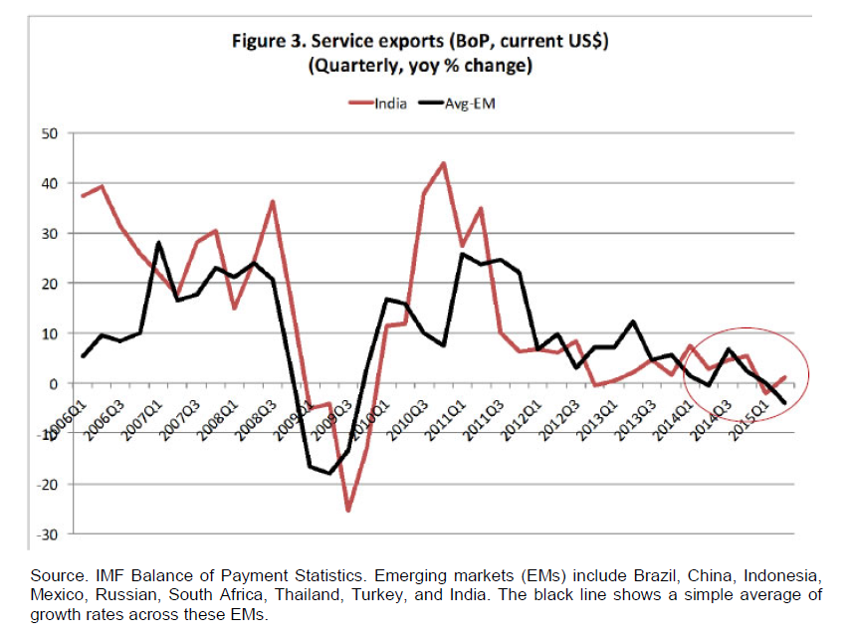

Slide 8
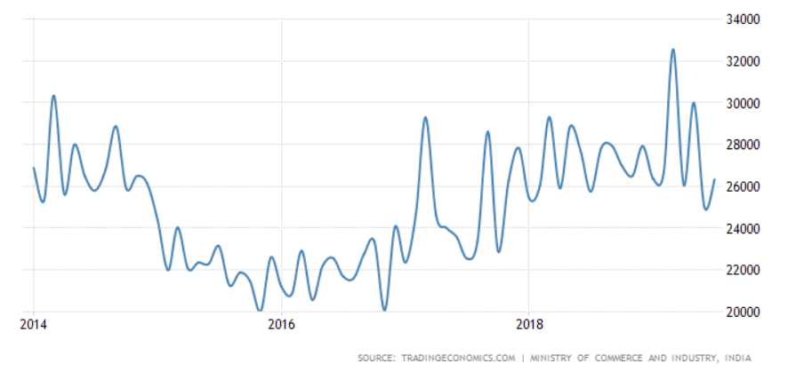
Current Exports Scenario
Exports rose to 26.33 bn (from 2016) and trade deficit narrowed to 13 bn from 18 bn (in past 1 year)
All figures in Crores INR

Slide 9
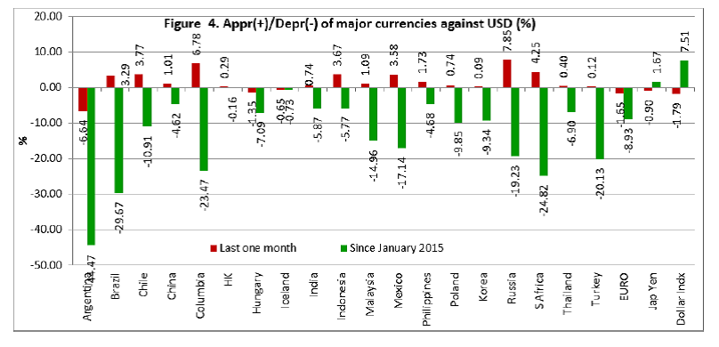
The Exchange Rate
If the currency depreciates then the exporters benefit
But other currencies depreciated even more benefitting the foreign producers more
So the author suggests looking at an index which compares rupee to other currencies by weighing each by their share in the trade

Slide 10
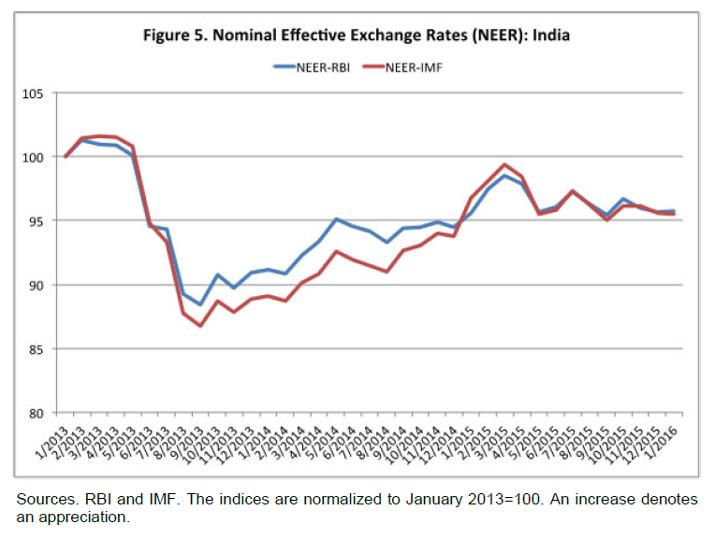
The Nominal Effective Exchange Rate
Rupee remained relatively flat in 2015
What Rupee gave against the dollar, it has gained against Euro or the Real
But are we neglecting inflation here?

Slide 11
If a widget cost a dollar to make a year ago in the United States, and ₹63 in India then, the Indian producer would have been competitive with the United States because the dollar was worth ₹63.
But if inflation in India is 5% and zero in the United States, it would cost the Indian manufacturer ₹66.2 to make it today. If the rupee stayed at ₹63 to the dollar, the Indian manufacturer would have become uncompetitive today – the US producer would be able to manufacture the widget at a cost equivalent of ₹63 only.
In other words, to retain competitiveness, the rupee has to depreciate by the inflation differential vis a vis a trading partner. An index of how competitive we are is called the “real effective exchange rate”. Think of that as the nominal effective exchange rate adjusted for inflation. The higher it is, the less the exchange rate has depreciated to offset inflation, and the more uncompetitive we are.

Slide 12
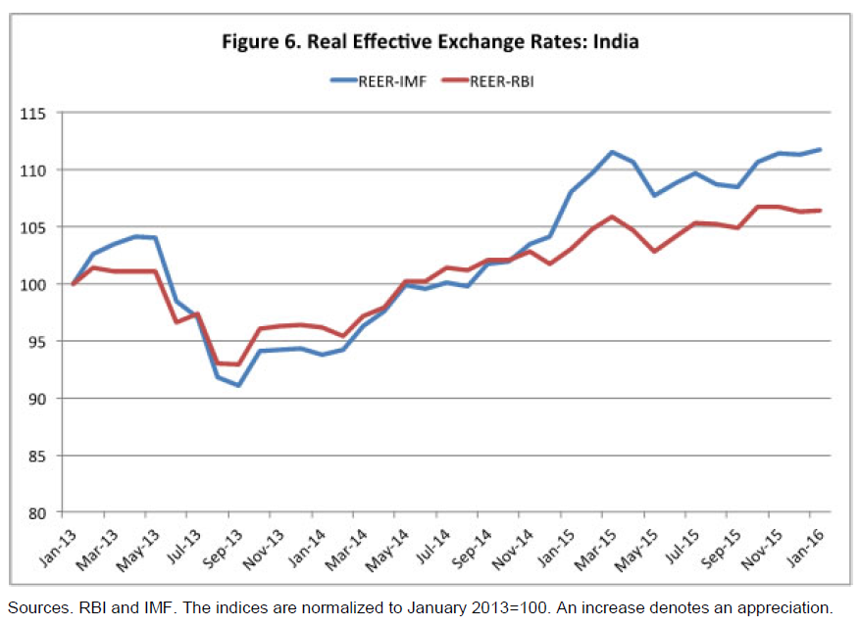
The Real Effective Exchange Rate

Slide 13
The real exchange rate is only one measure of competitiveness
Productivity of the country matters
Domestic bottlenecks account for more than 50% of the lack of competitiveness
What to do? ---
Build better infrastructure, better transport, manage inventories better etc

Slide 14
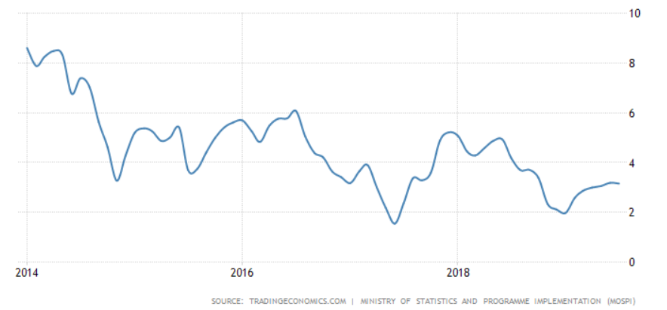
Unanswered Questions
Inflation Rate in India on the left
Even after the fall of inflation rate in India in the subsequent years the Indian currency has devalued from 58 (in 2014) to an all time high of 74 (in 2019) – a depreciation of around 25%
What industries to focus on?

Slide 15
The Goldilocks Rate
The Non-Economist ( Consumer View) – Strengthen the Rupee – Increase spending power
The Economist View – Undervalue – Helps exports and tourism
Author suggests: Undervaluation is a subsidy to domestic producers paid for by domestic consumers and savers
An undervalued exchange rate might have made sense in the past for countries that had weak firms and small domestic markets. India is in a very different position today from the export-led East Asian tigers when they embarked on their growth path. The ideal exchange rate for India is neither strong nor weak, it is just right.

Slide 16
To maintain orderly movement of the rupee versus other currencies:
First, good policies that ensure macroeconomic stability and convinces investors their money is safe over the medium term
Second, focus on attracting stable capital flows that will stay for the long run. This means resisting the temptation to open up too much to short-term- as well as foreign currency denominated debt flows in good times, no matter how low an interest rate they charge.
Finally, the Government has been encouraging foreign investors to “Make in India”. One offshoot of this campaign has been a sizeable rise in foreign direct investment, the most stable sort of investment.

Slide 17
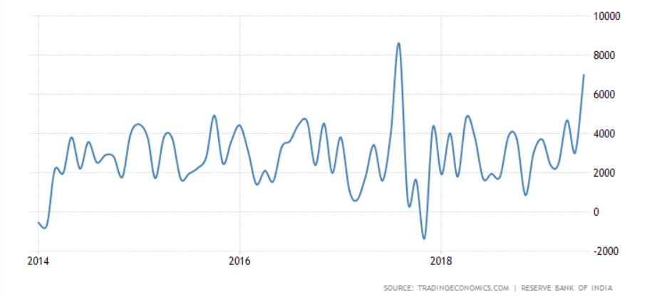
FDI in India

Slide 18
Current Economic Scenario
Economic Slowdown-
INDIA: GDP growth rate of 5% (first quarter FY20) on a base of 2.9 trillion dollar economy
CHINA: Even during the trade war has managed to get 6.3% growth rate ( 27-year low) in GDP on a base of 13 trillion dollar economy
Demonetization- Failure of Indian Govt – Reduced Cash in hand in a cash driven economy – led to decrease in corporate investment by 60% which affected manufacturing and construction industries
99.3% came back
Nepal, Bhutan, NRI, donation boxes, poor people
Budget 2019 – Increased custom duties and GST (goods and service tax) on import – Foreign Investors pulled out $ 22.5 bn in past few months
Unemployment Rate – Highest in the past 45 years (~ 7%)

Slide 19
Public Sector Banks merged – now 12 from 27 –to reduce NPA – makes less sense for the economy
2.4 lakh crore of bad debts written off in public banks
17.6 lakh crores taken from RBI funds

Slide 20
Ideas and Analysis
India now has a say in international matters and is a part of multilateral and bilateral treaties but it is yet to build its place
The international bodies are still dominated by the G7 nations( US, UK, Canada, France, Germany, Italy , Japan)
Author praises India’s efforts in engaging in BRICS ( Brazil, Russia, India, China, S. Africa)
India should build a relationship with other emerging nations, build capacity, focus on providing good education and building capabilities

Slide 21
Final Thoughts
Covered good points and backed them with relevant data but failed to mention the effects in the long term
Did not cover the industries India could focus on, the GDP drivers and about how Reserve Bank of India could play an important role in building the nation
Focused more on the positive aspects of the economy while it could have been a good mixture of negative things which India could improve upon
Could have talked about the intervention of government in making/influencing the decisions of RBI (which made him leave his office shortly after (6 months later) this talk took place

Slide 22
Thank you very much for your time!!!

